Slide 1
Monitoring a Real-Time MAUI App with SignalR OpenTelemetry and Grafana

Slide 2
Thanks to MILL5

Slide 3
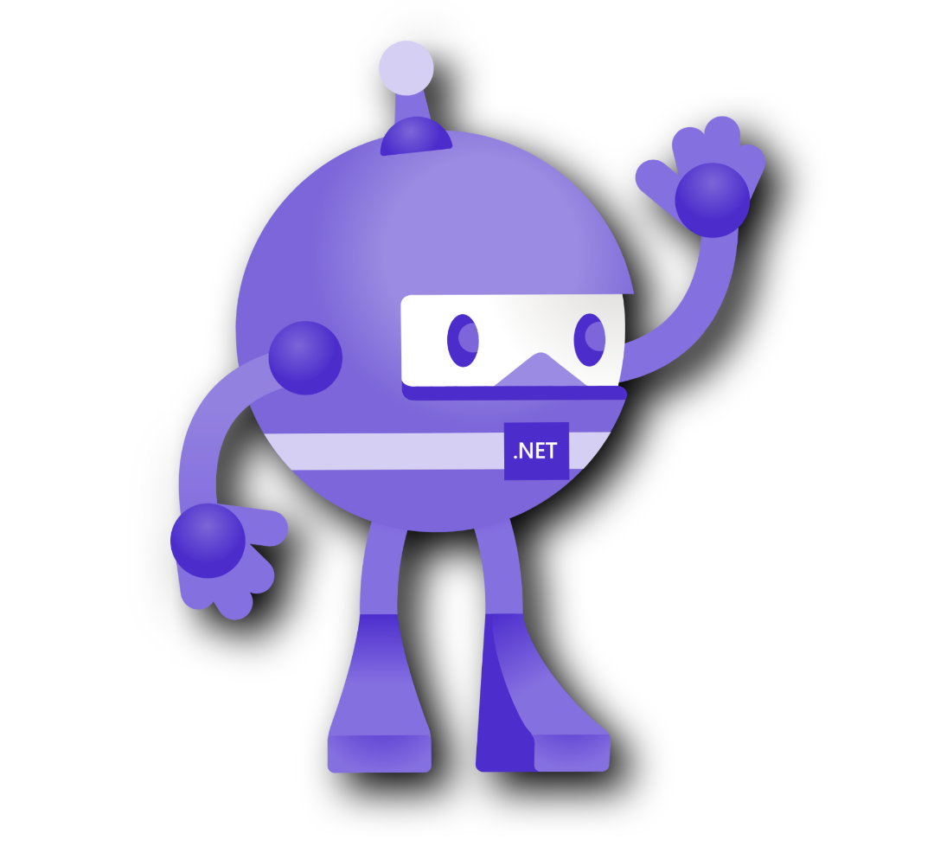
What is MAUI?
Cross-platform application development framework for iOS, Android and Windows from the same code base (C# - XAML- Blazor).

Slide 4
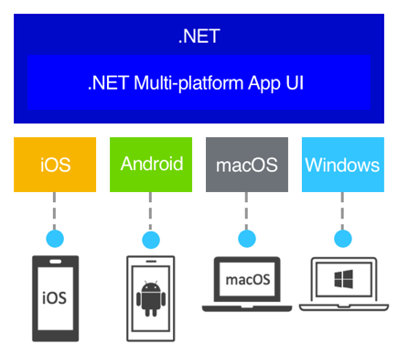
MAUI Architecture

Slide 5
Demo 1
Show UI

Slide 6

What is SignalR Core?
Provides a simple way to add real-time functionality to applications. Ability to establish bidirectional connections.

Slide 7
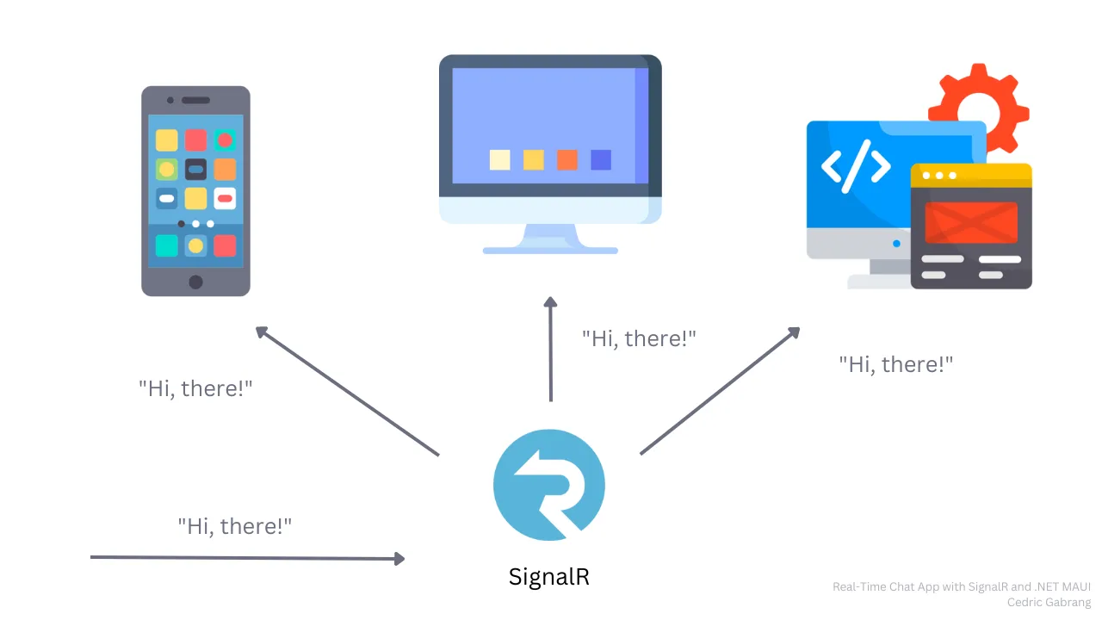
SignalR Architecture?

Slide 8
Demo 2
SignalR Hub Server

Slide 9
What is Observability?
“When you run an application, you want to know how well it is working and detect potential problems before they escalate. You can do this by emitting telemetry data, such as logs or metrics, from your app and then monitoring and analyzing that data.” Microsoft

Slide 10
What is Observability?
“In the context of a distributed system it is the ability to monitor and analyze telemetry about the status of each component, to be able to observe changes in performance and diagnose why those changes occur.”
Microsoft

Slide 11
What is Observability?
Essential to identify bottlenecks, measure performance and health of a system.
Pillars: Metrics, Logs, Traces.

Slide 12
What is Telemetry?
Process of collecting data from a source and communicating it remotely to allow monitoring and analysis.

Slide 13

What is OpenTelemetry?
Agnostic observability tool that offers APIs and SDKs in a standardized way to instrument, generate and export telemetry for applications monitoring and analysis.

Slide 14
What is NOT OpenTelemetry?
It is not an Observability Backend like Jaeger or Prometheus, etc.
It is focused on the generation, collection, management and export of telemetry.

Slide 15
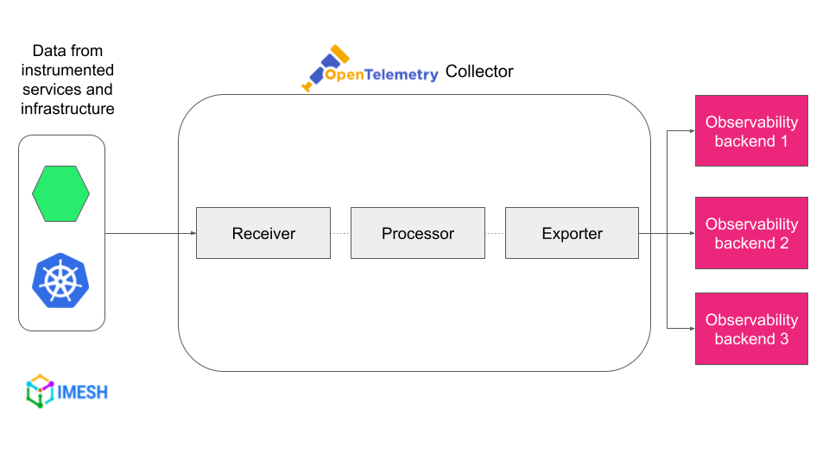
OTEL Architecture

Slide 16
OTEL Use Cases
Measure loading time of a web page.
Latency of a component (waiting time).
Know about unhandled errors.

Slide 17
Other Concepts
Instrumentation: Specific code that must emit metrics, logs, traces.
Agnosticism: Not tied to a programming language.

Slide 18

What is Grafana?
Platform with high capacity to visualize and analyze telemetry in real time.

Slide 19
Demo 3
Download prometheus.
Configure prometheus.yml (port and time).
Download and install grafana.
Associate prometheus datasource to grafana.
Instrument (coding) in c#.
Check telemetry in UI.

Slide 20
Demo 4
Surprise!

Slide 21
Questions?
Logging and Traces?
Can I send telemetry in batches?
Alerts for errors?
Beforehand thank you very much!

Slide 22
Sources
Demo repository.
OTEL.
Microsoft.
Google.
Logz.io
Prometheus.
Grafana.
.NET Aspire Dashboard.

